Slide 1
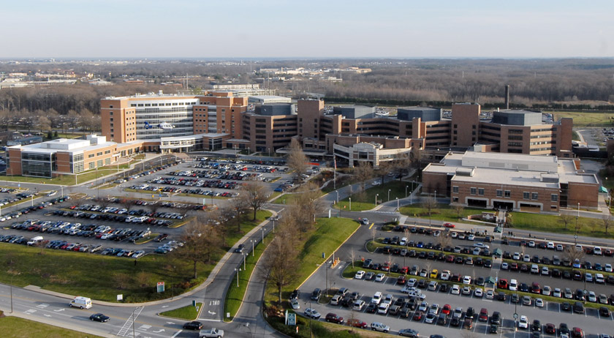
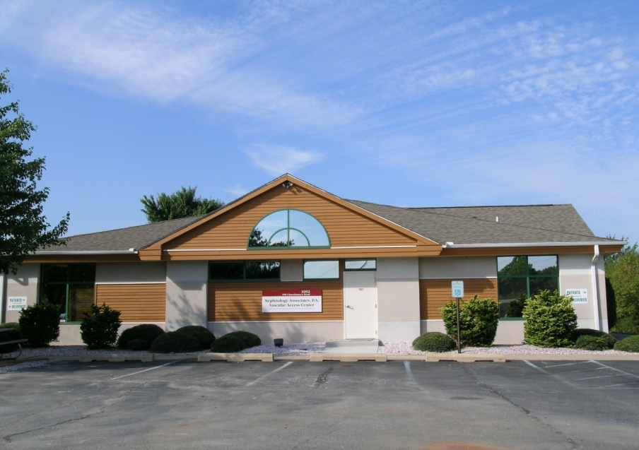


Management of the
Immature Fistula
Theodore F. Saad, M.D.
Nephrology Associates, P.A.
Newark, Delaware

Slide 2
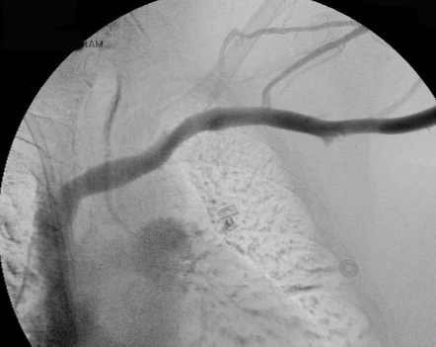
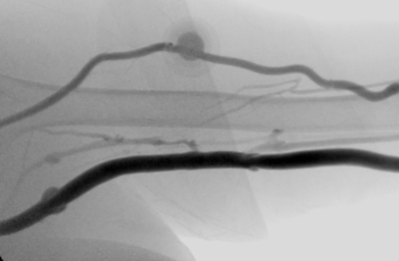
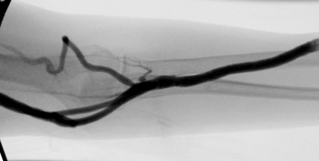
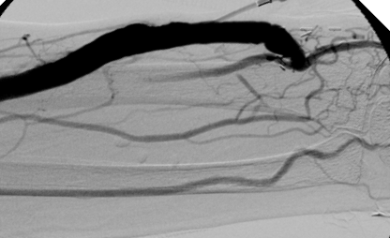
“Mature” Fistula?

Slide 3
What is a “Mature” AVF?
Vein able to be safely and reliably accessed 3 times per week with two 17, 16, or 15 ga. dialysis needles
  Diameter: >6 mm
  Depth: <6 mm
  Length: >6 cm
    Straight
  Vessel Wall quality
    “Arterialization”
Fistula flow sufficient to deliver necessary rate of blood to the dialysis circuit
  >150% of desired pump speed: e.g. 400 ml/min
  >600 ml/min
Dependent upon
  Cardiac output
  Blood pressure
  Artery size & quality

Slide 4
Fistula Maturation &
Adequacy of Hemodialysis
Adequacy as assessed by urea clearance
  Kt/V: Fraction of total body distribution volume cleared during dialysis session equals
  K_{urea} = Dialyzer urea clearance
  Td = Dialysis time
  V_{urea} = Urea distribution volume
    Approximates total body water
Target Kt/V >1.4

Slide 5
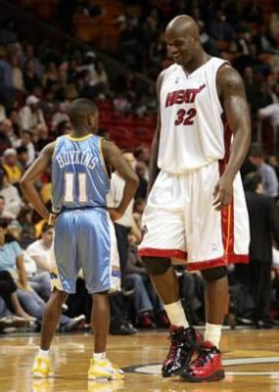
KT/V & Adequacy:
One Size Doesn’t Fit All

Slide 6
KT/V & Adequacy:
One Size Doesn’t Fit All
100 kg patient: Kt/V=1.4
50 kg patient: Kt/V=1.4
Urea volume = 60,000 ml
Time = 240 minutes
K_{urea} = 350 ml/min
Blood flow to dialyzer
  450-550 ml/min
  ≥15 gauge needles
Access flow >750 ml/min
Urea volume = 30,000 ml
Time = 240 minutes
K_{urea} = 175 ml/min
Blood flow to dialyzer
  200-250 ml/min
  17 gauge needles
Access flow 300 ml/min
Less efficient dialyzer urea clearance at higher blood flow rates
Requires access blood flow 50% greater than dialyzer pump speed

Slide 7
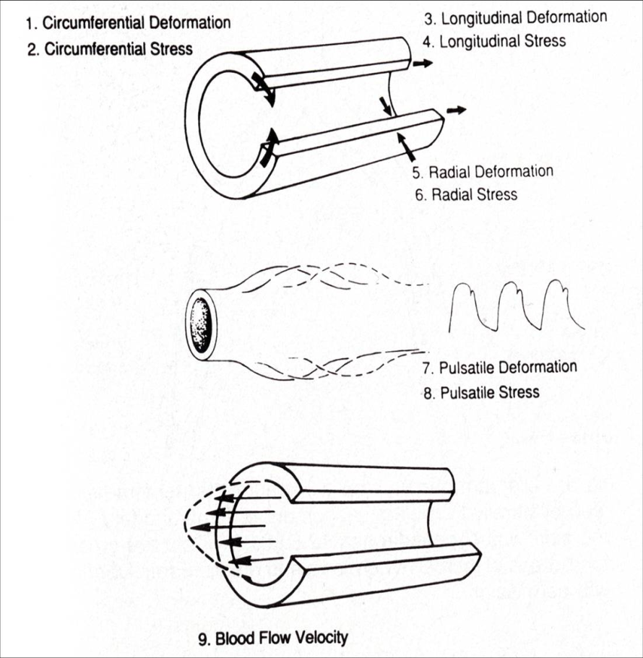
AVF Maturation:
Hemodynamic Factors
Dobrin et al: Surgery 105:393-400, 1989
Courtesy of Arif Asif, M.D.

Slide 8
AVF Maturation:
Humoral Factors
Adaptive Remodeling
  Reorganization of cellular and extracellular components
Role of Endothelial Cells:
  De-endothelialized vessels fail to increase diameter in response to increased blood flow (1, 2)
Shear stress:
  Apical surface of the endothelial cell
  Transduction of hemodynamic forces
  Subendothelial compartment
    Nitric oxide, prostacyclin
    Activation of a variety of transcription factors and matrix metalloproteinases (3)
  NO and MMPs: Appear to play a major role.
1- Tohda et al:. Arterioscler Thromb 12:519-528, 1992.
2- Langille BL, O'Donnell F: Science 231:405-407, 1986
3- Ballermann et al: Kidney Int 67:S100-S108, 1998
Courtesy of Arif Asif, M.D.

Slide 9
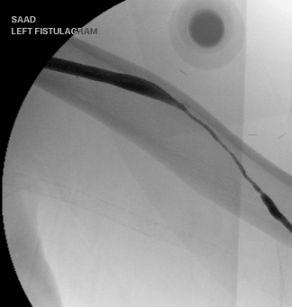
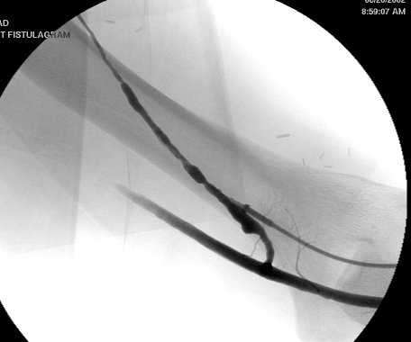
LUA Transposed Cephalic AVF:
Delayed Maturation

Slide 10
Native Arteriovenous Fistula:
Patterns of Maturation

Slide 11
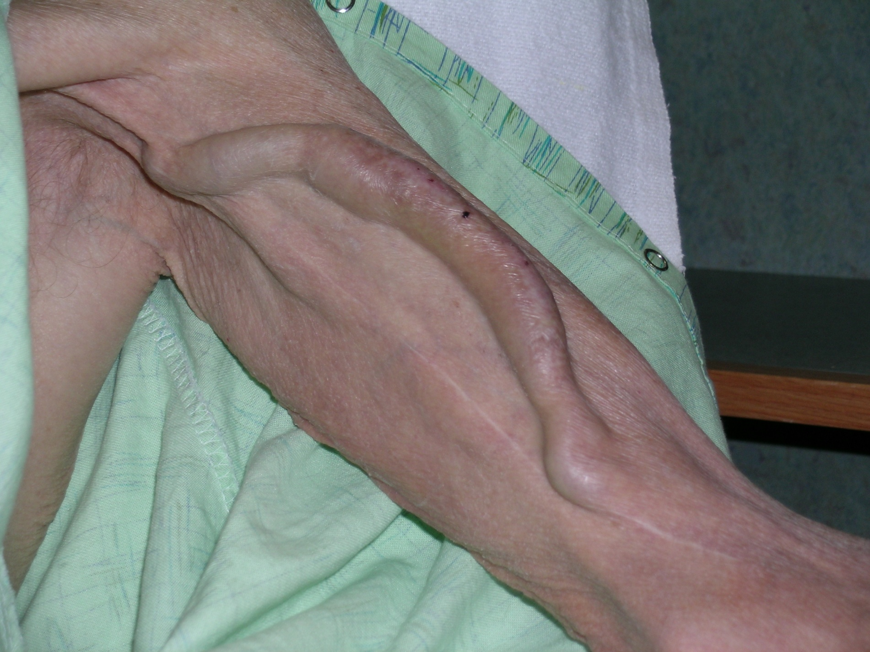

Slide 12
Some Fistulas Fail to Mature
Kidney Int, 2001 Kidney Int, 2001 AJKD, 2001
Notes:
While it is recommended that fistulas mature 3 to 4 months prior to utilization, a longer “bridge” time may be required since a large percentage of fistulas may not be accessible even after this time period due to a failure for the fistula to mature as a result of poor blood vessels, thrombosis, or pre-mature cannulation of the fistula prior to fistula development. If the primary fistula fails to mature, another permanent access needs to be created and allowed to mature prior to removal of the bridge device.

Slide 13
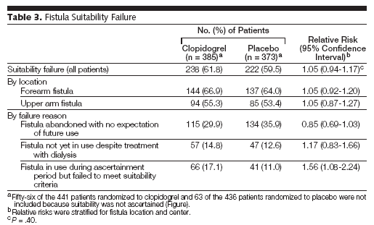
Effect of clopidigrel (Plavix™) on Early Failure of AV Fistulae
Dember, et al., JAMA 2008

Slide 14

Physical Training:
Myth of the Red Rubber Ball
Immediate effects
Oder (ASAIO 2003)
  23 patients
  AVF 2.8 months old
  5 minutes hand exercise
    Red rubber ball
  Fistula diameter increased 9.3%
    20/23 patients
Long-term effects
Rus (Blood Purif 2003)
  14 ESRD patients without AVF
  8 weeks Handgrip training
  Increased
    Radial artery diameter
    Maximum vein diameter

Slide 15
Failure to Mature
Focal venous stenosis
  Pre-existing vein damage or disease
  Surgery-related vein damage
    Juxta-anastomotic or “swing-point” stenosis
Diffuse vein stenosis
  Intrinsic vessel disease
Accessory or “competing” veins
Hemodynamic factors
  Arterial calcification
  Poor cardiac output and/or blood pressure
Failure to squeeze the ball

Slide 16
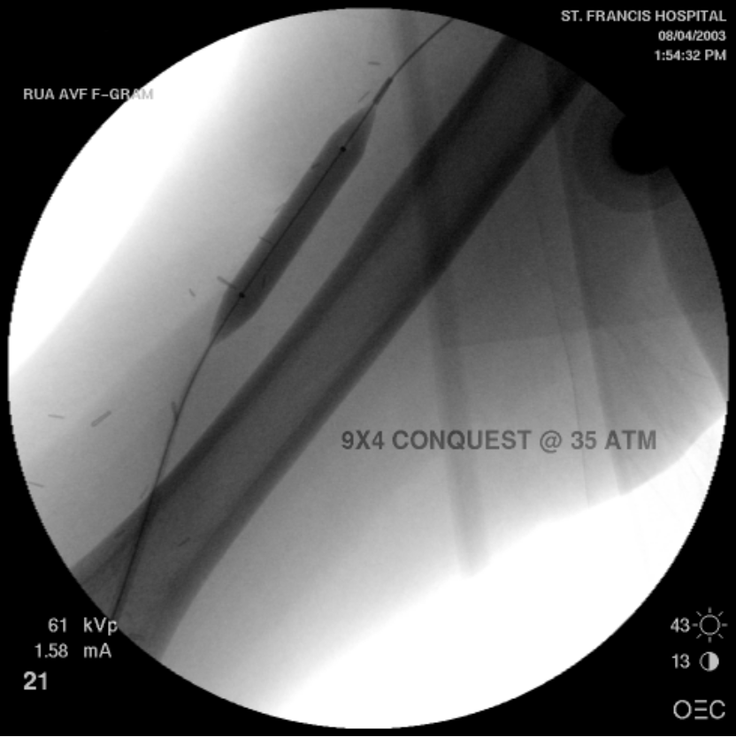
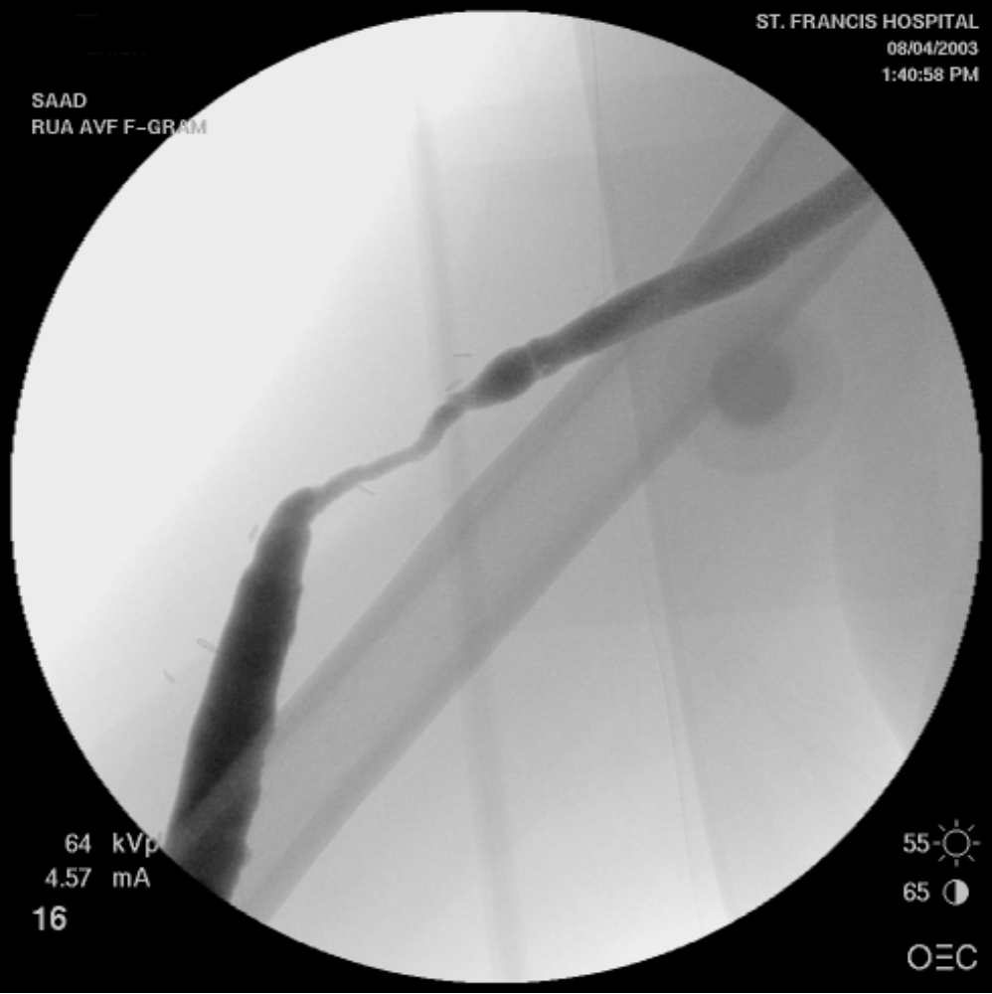
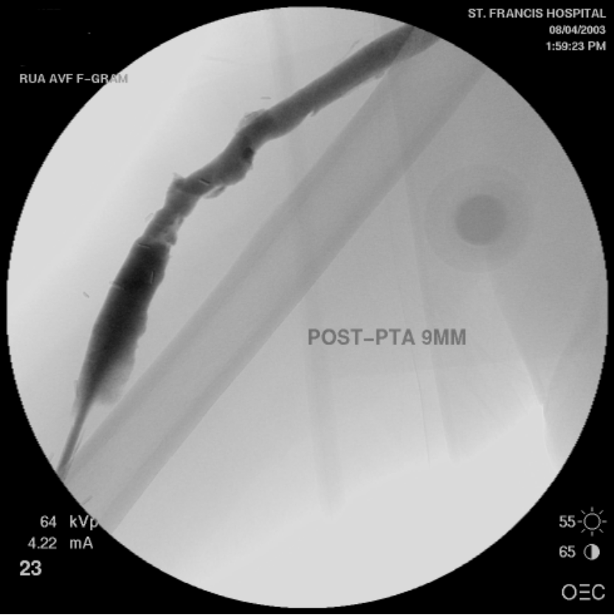
“Swing-point” Stenosis

Slide 17
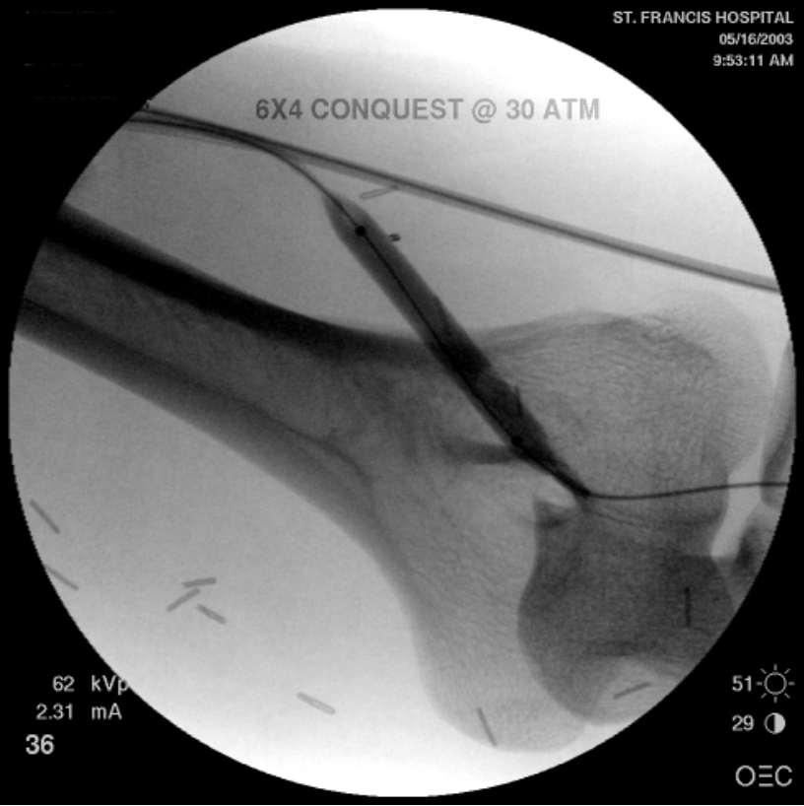
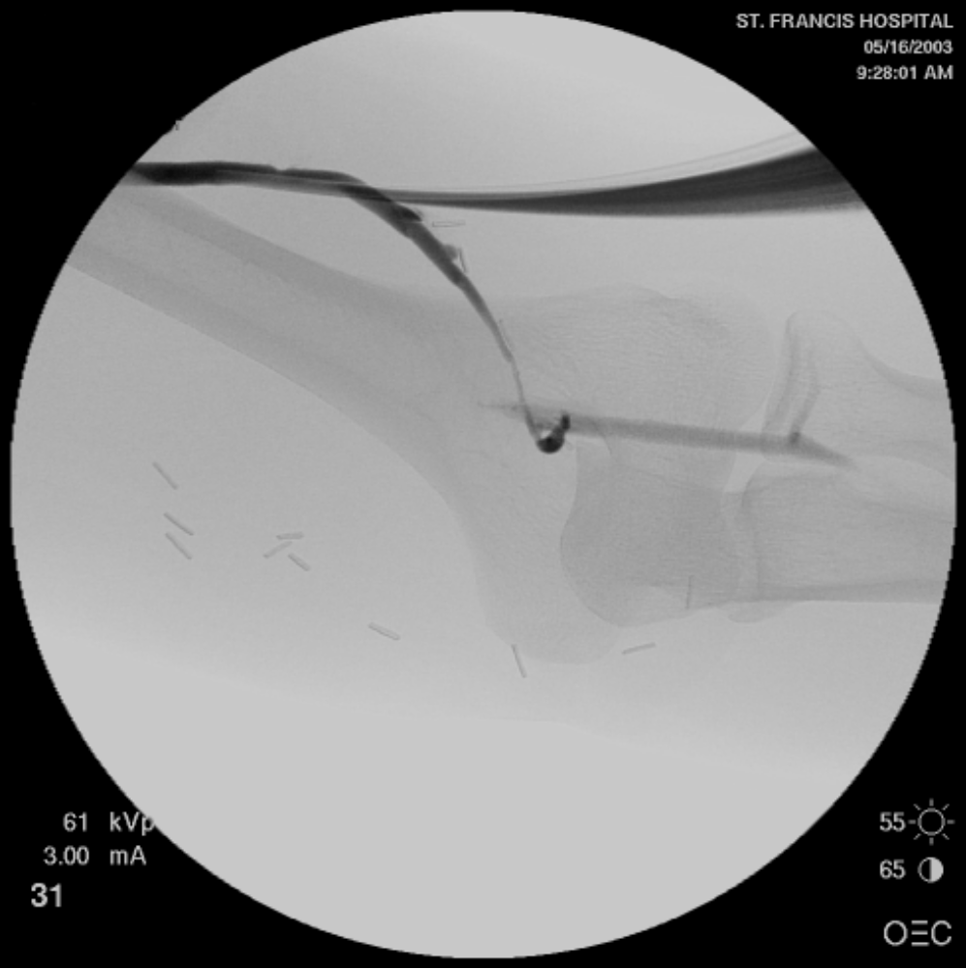
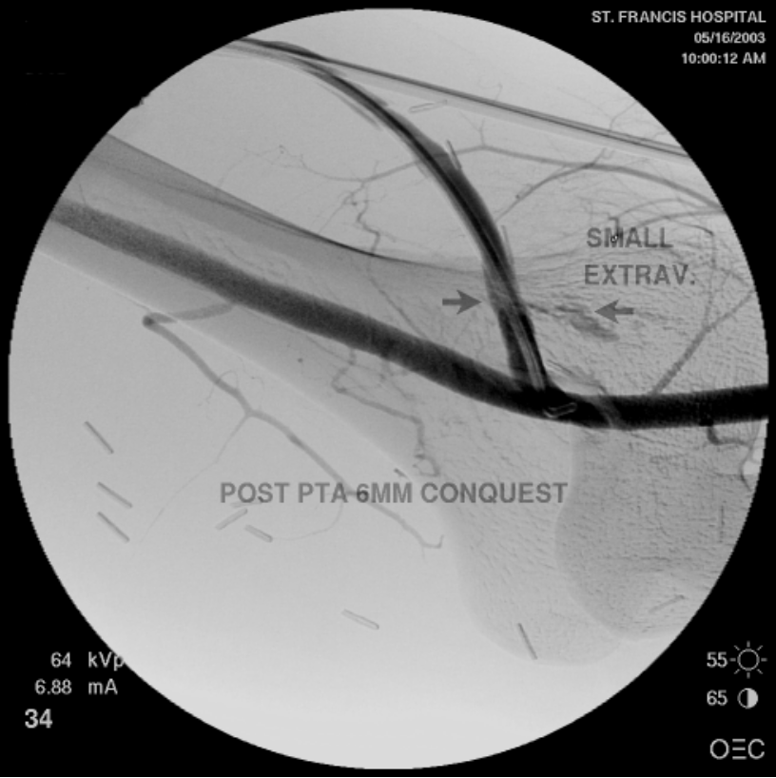
Juxta-Anastomotic Stenosis

Slide 18
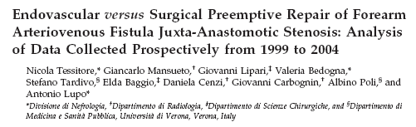
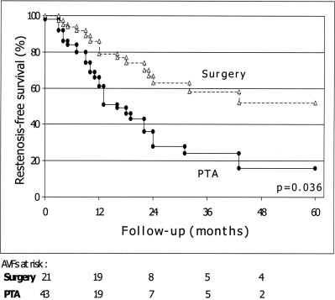
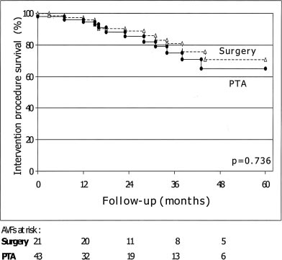
Primary Patency
Assisted Primary Patency

Slide 19
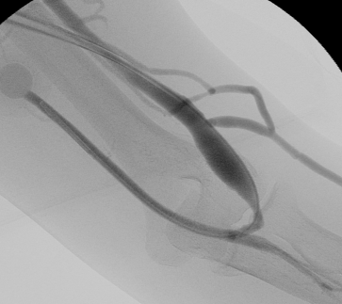
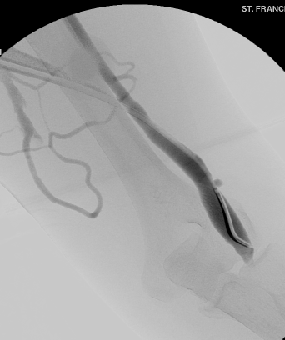
AVF Maturation:
Competing or Accessory Vein Ligation

Slide 20
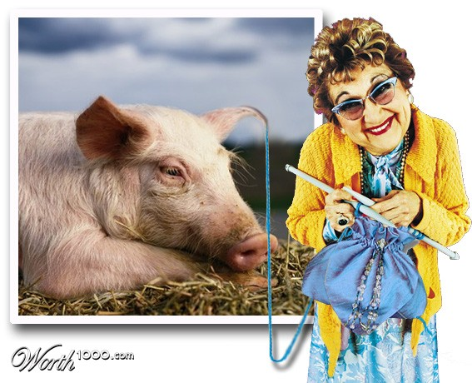
Balloon Assisted AVF Maturation:
“Silk purse from sows ear?”

Slide 21
“Balloon Maturation”
Definition
Use of balloon angioplasty to achieve long-segment vein dilation that has not occurred spontaneously
  Involves the intended fistula puncture zone
  Sequentially larger balloons
Distinct from treatment of focal stenosis
  Juxta-anastomotic or swing-point
Limited data

Slide 22
Staged Balloon-Assisted Aggressive Maturation (BAM)
122 patients retrospective
  Class I
    Large (6-8 mm) vein
    > 6 mm deep
  Class II
    Small (2-5 mm) vein
Sequential dilation
  Angioplasty at 2-4 week intervals
    Start with at least 6-7 mm diameter balloon
    Successively larger balloons :10-12 mm (max 16 mm)
    Long length balloons for long segment lesions
  Repeated until fistula usable
  Successful maturation: 118/122 (96.7%)
Miller et al: JVA 2009

Slide 23
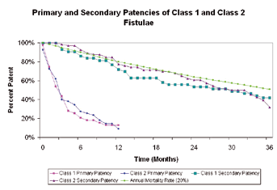
Staged Balloon Assisted Aggressive Maturation Protocol
Secondary Patencies
Class I & II Primary Patency
Miller et al: JVA 2009

Slide 24
Interventions to Improve
Fistula Maturation Rates
Meta-analysis
  12 Reports, 745 patients
  Variety of surgical and percutaneous methods
    Angioplasty, stent, thrombectomy
    Branch vein ligation
    Surgical revisions
  86% success in achieving functional fistula
  At 1 year
    Primary patency 51%
    Secondary patency 76%
Voormolen, et al., J Vasc Surg 2009

Slide 25
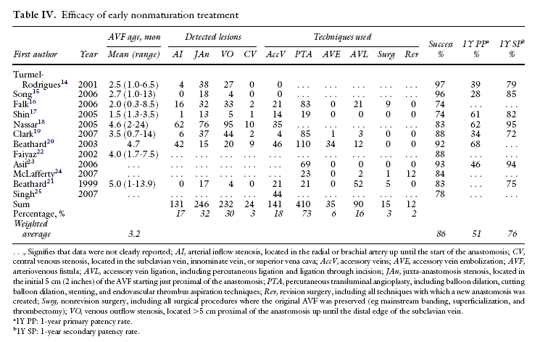
Voormolen, et al., J Vasc Surg 2009

Slide 26
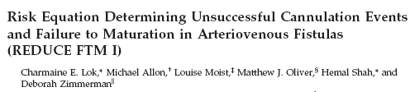
Risk factors for FTM in 422 patients receiving first AVF
Risk Equation
  Age ≥65 (OR: 2.23)
  Peripheral Vascular Disease (OR: 2.97)
  Coronary Artery Disease (OR: 2.83)
  White Race (OR: 0.43)
Scoring System
  Base score “3”
  Add score for factors
Values
  +2
  +3
  +2.5
  -3
* Factors NOT correlated with FTM: Diabetes, obesity, gender, smoking

Slide 27
Scoring System
Total Score 0 to 10.5
Risk for Failure to Mature validated in prospective in group of 445 patients receiving first AV Fistula
  Score Risk FTM Suggested Strategy
  ≤ 2 Low 24% PE & Routine mapping
  2-3 Moderate 34% Add venography
  3.1-7.9 High 50% Intense follow-up
  ≥ 8 Very High 69% Consider graft

Slide 28
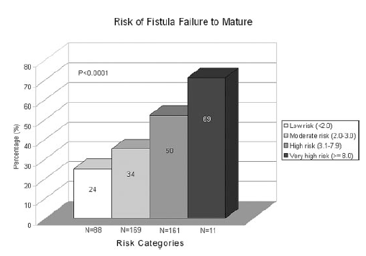

Slide 29

Fistula Creation
Side: Right Left
Site/Type:______________
Surgeon:_______________
Date:__________________
Fistula Maturation Protocol
Refer to Interventionalist or Surgeon for evaluation and possible ultrasound examination or fistulogram.
Potential problems include:
Inadequate inflow
Venous outflow stenosis
“Deep” fistula requiring transposition.
Accessory veins limiting flow
Examine at 4 weeks
Date:__________
Is fistula adequate size for cannulation (>6 mm)?
Is fistula superficial (<6 mm deep)
Does fistula have a good continuous “thrill” & bruit without excessively pulsatile quality?
No
Yes
Re-examine 4 weeks after intervention, or per recommendations of interventionalist.
Date:____________
Attempt fistula cannulation
Attempt Needle Cannulation at 8 weeks
Date:_________
Begin single 17 gauge cannulation
Advance to 16 gauge and then 2 needles as able
Measure access flow after successful 2 needle cannulation (if available)
Cannulation Protocol available At www.fistulafirst.org
After evaluation and/or intervention, attempt cannulation protocol.
If still not successful, patient should be referred back for re-evaluation
every four weeks. Log dates here for interventional evaluation.
Date_____________
Date_____________
Date_____________
Date_____________
Two weeks of continuous successful fistula cannulation?
Date:______________
Refer to Interventionalist or Surgeon for evaluation
No
Yes
Schedule catheter removal
Successful cannulation?

Slide 30
Fistula Maturation in CKD Patients not yet Receiving HD
Reports demonstrate effective imaging, low risk for CIN with low-dose contrast in CKD patients
  Asif et al, Semin Dial 18:239-242, 2005
    25 patients CKD 4 or 5
    Venography using 10-20 cc
    No CIN
  Kian et al., KI 69:1444-9, 2006
    34 patients CKD-4
    65 studies
    Mean contrast volume 7.8 cc
    CIN in 4.6% at one week, no sequelae, returned to baseline
Recommend:
  Treat AVF maturation failure in CKD patients similar to ESRD
  Low volume contrast
    Targeted imaging
  Be relatively patient
    Don’t wait for thrombosis
    Don’t wait until needed to start HD

Slide 31
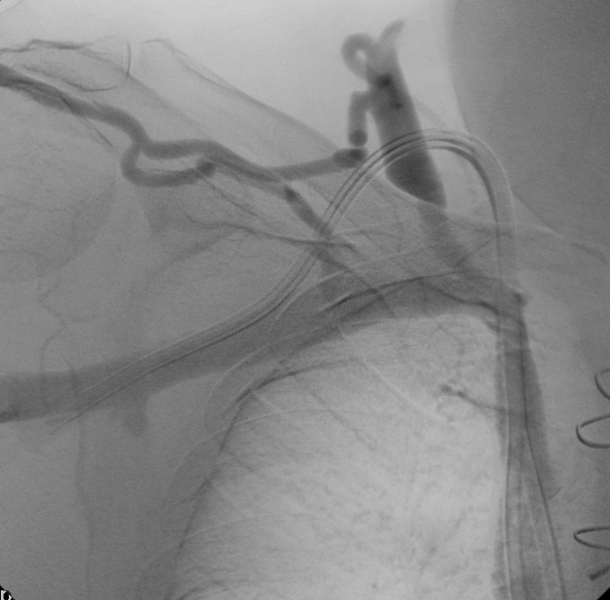
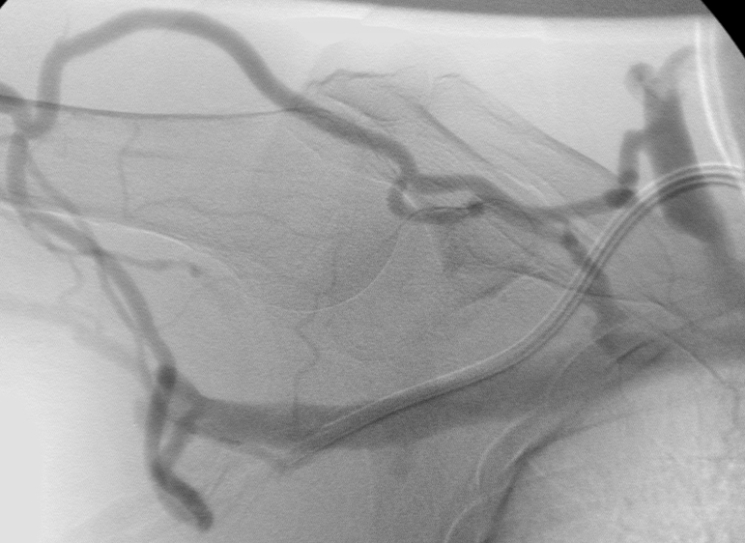
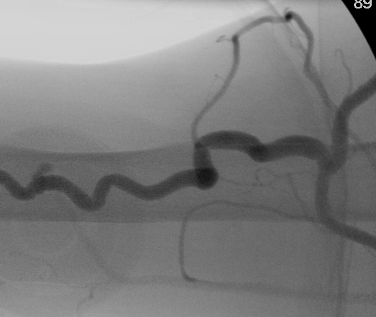
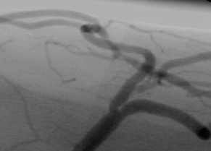
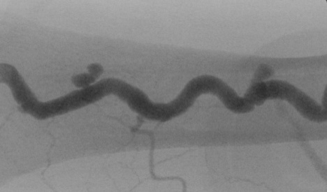

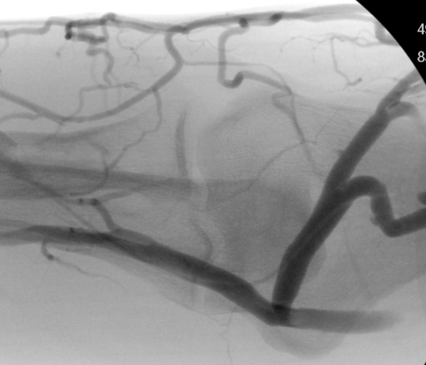
What does one do with this fistula?!
Stenosis
Variant arch to external jugular vein
Needle site
pseudoaneurysms
Collateral or accessory veins
Collateral veins to basilic system
Tortuous
Cephalic vein
Vein deep
Chronic steroid skin changes

Slide 32
What to do with this fistula?
Opinions solicited from interventional on-line discussion group, nephrologists, radiologists, vascular surgeons
  Abandon & place graft in same arm
  Abandon & create new fistula in left arm
  Angioplasty everything in sight
  Stent-graft entire putative puncture segment
  Surgically straighten, transpose, turndown to basilic vein
  Attempt to use “as-is” with buttonhole needles

Slide 33
AV Fistula Maturation: Summary
A “good” fistula will have
  Thrill & high flow immediately post-creation
  Dominant dilated superficial vessel
Evaluate early for poor maturation
  Inflow stenosis
  Calcified radial artery
  Sclerotic vein
  Competing vein branches
  Deep vein
Don’t wait months or years to intervene
  Intervene early and often until usable or failed
  Establish “forward progress”
Abandon “hopeless” AVF sooner rather than later & create something better

Slide 34
AV Fistula Maturation
Information
Fistula First “Change Concepts”
  Routine CQI Review of Vascular Access
  Early referral to nephrologist
  Timely referral to surgeon for AVF “only”
  Surgeon selection based upon outcomes
  Utilize full range of techniques for AVF
  Secondary AVF
  Track catheters & convert to AVF
  Cannulation
  Monitoring & maintenance
  Education
  Outcomes Feedback

